Slide 1

Introduction to Artificial Intelligence
Ashenafi. W(MSC.)

Slide 2
Details about the Course
Course has 5~6 chapters
The instruction will consist of lectures and lab classes
Assessment:
  Continuous Assessments: 60%
  Final Exam: 40%
By the end of this course:
Describe the key components of the artificial intelligence (AI) field
Outline search strategies and solve problems by applying a suitable search method
Grasp how agents' reasoning works
Understand the issues related to agent planning, handling uncertainty, learning from observation and communicate.

Slide 3
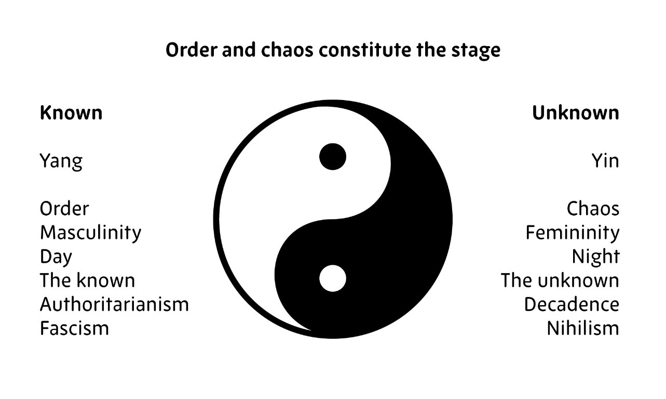
Important Stuff to take care of before beginning the Course
Representative for the course ?
Contact:
  Phone Number:
  Email:

Slide 4
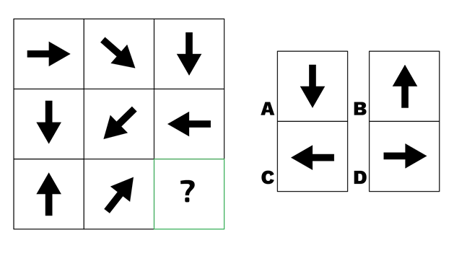


Intelligence – What is it?
Defined in a human context: able to
  Reason in an abstract manner
  Mental representation (purpose based?)
  Problem solving
  Learning
  emotional knowledge
  creativity
Most of all it is adaptation to meet the demands of the environment effectively

Slide 5
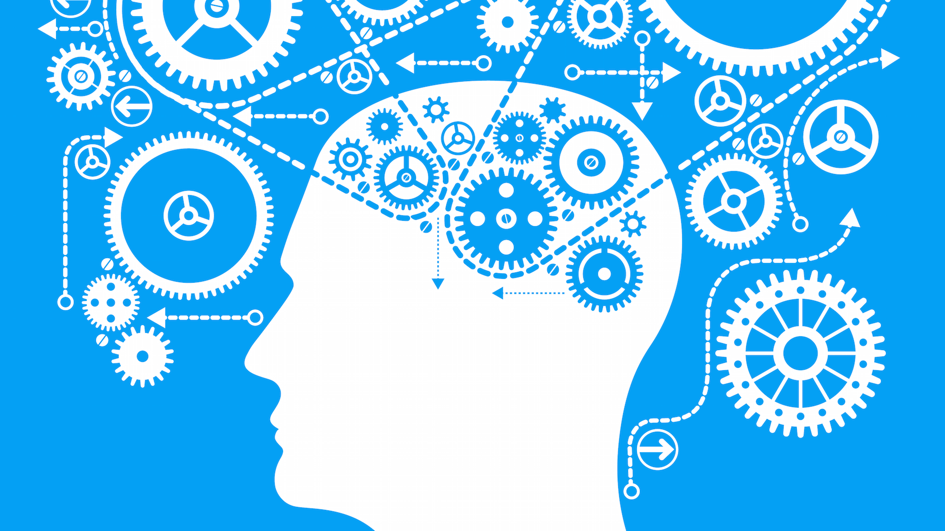
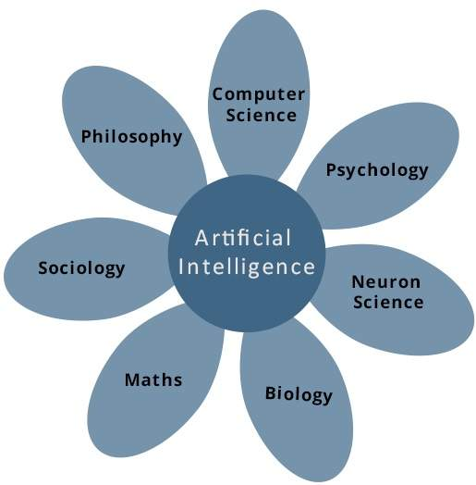
Artificial Intelligence
As a discipline it attempts to understand and develop intelligent entities
The fundamental assumptions made under AI are:
  Workings of human mind can be explained in terms of computation
  Computers can do the right thing given correct premises and reasoning rules
It is an interdisciplinary field brought forth by the efforts of several disciplines

Slide 6
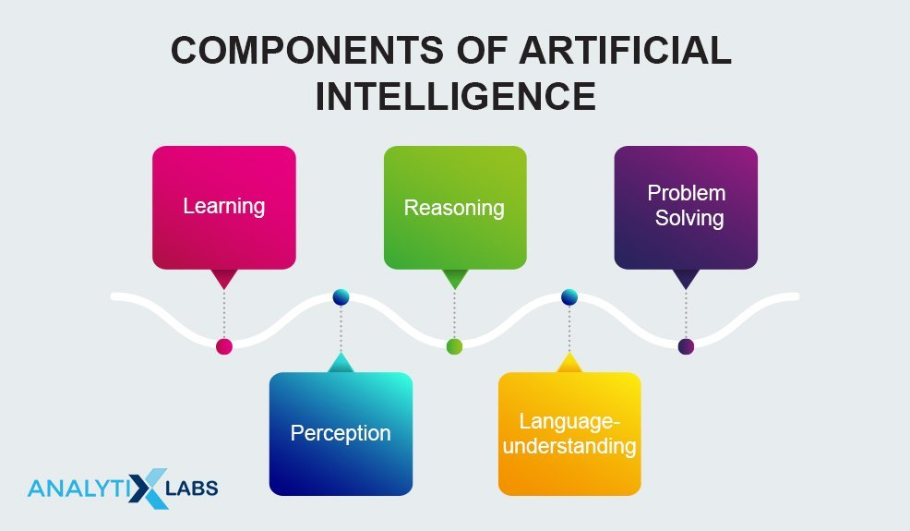
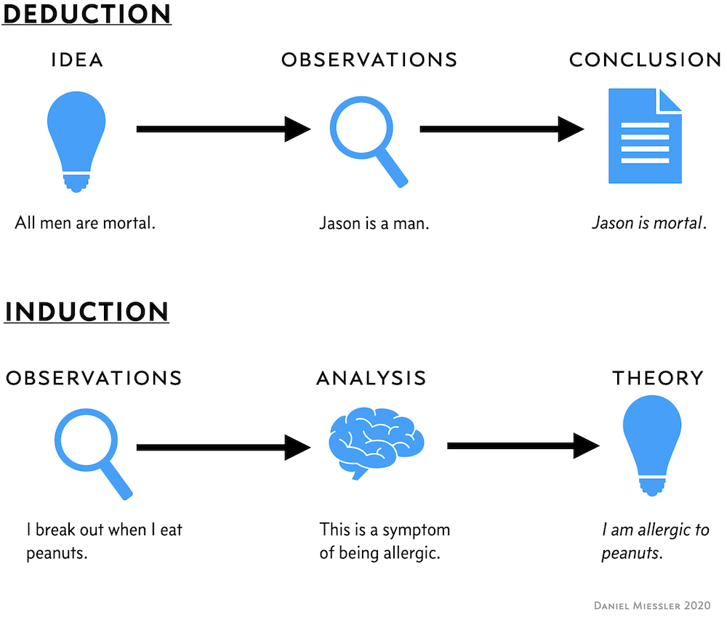
Components of an AI System
Perception: scan the environment using different sensors – Camera, Ultrasonic sensors, LiDAR, etc.
  Internally the scanned information is interpreted to understand the background
Language Understanding: speech, written statement, signs and symbols
Learning: trial and error based learning, memorizing solutions to different problems, vocabulary etc.
  Use these later for different task
Reasoning: make inferences given a set of premises/based on the current situation
  Inductive vs Deductive inferences/reasoning
Problem Solving: Given a data find a solution to a problem
  Special purpose solution: customized solution to a specific problem
  General purpose solution: solution to a several problems
Notes:
Peanuts: ኦቾሎኒ

Slide 7
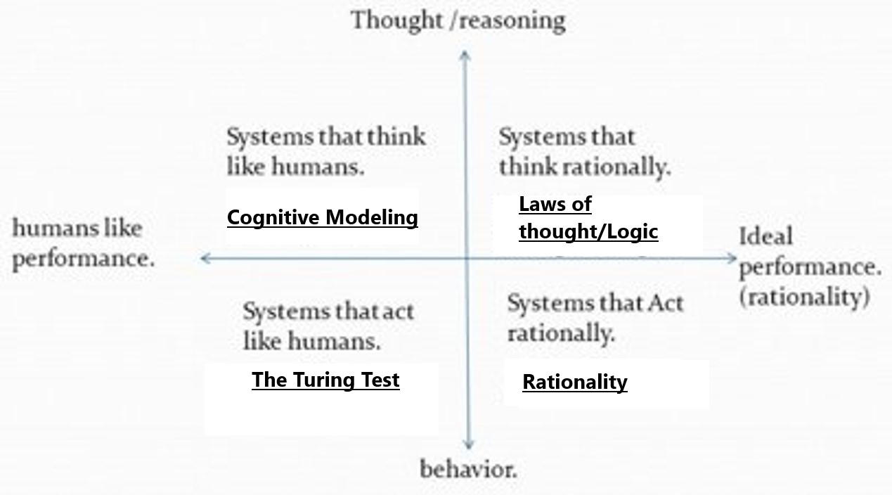
Approaches to AI
Several approaches exist to study AI:
  Human Centric approach: which derives much from humans
    Human thinking – internal
    Human Action – external
  Dissociate from humans and focus on doing the 'right thing’ – (perfection – because humans are limited)
    Rational thinking - process
    Rational action – behavior
    Important because there are numerous contexts where mimicking human thought/action is not important

Slide 8
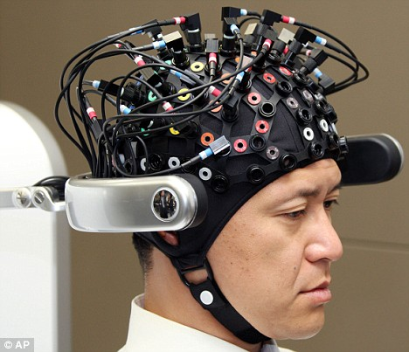

Human-centered Approach to AI
Thinking like Humans:
  Is a cognitive (?) modelling approach to AI
  Requires understanding of the internal activities of the brain via
    Introspection – observing ourselves
    Brain imaging — observing the brain in action
    Psychological experiments (E.g. Rorschach Test, )
  Formulate a precise theory of the mind, it becomes possible to express the theory as a computer program.
  Goal is to make program’s input-output behavior match human behavior (After testing)
  https://openpsychometrics.org/tests/HEMCR/

Slide 9
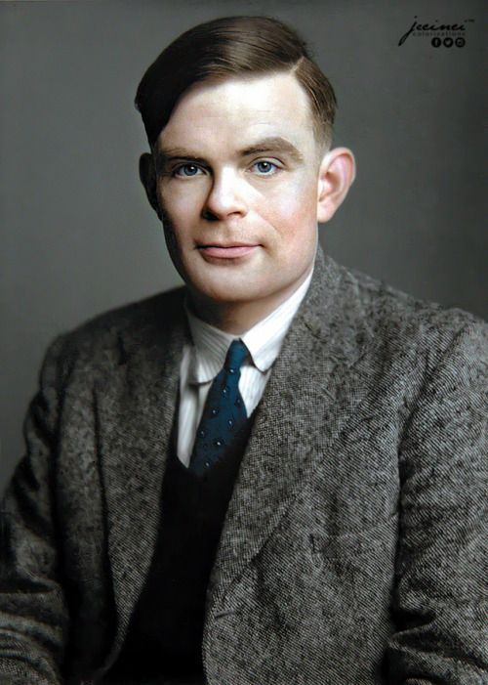
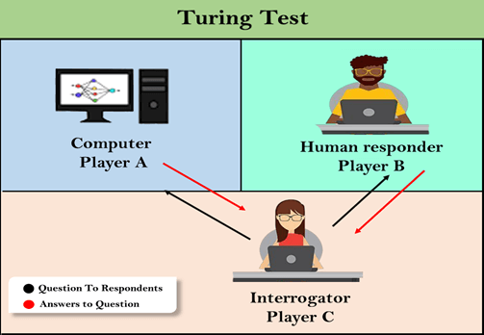
Human-centered Approach to AI
Acting Like Humans (Blackbox):
  A.K.A the Turing Test Approach
  Turing test: Assume there’s a person asking questions blindly (person/machine)
    If the person cannot distinguish the machine’s answer from the person’s the machine has passed the test
    Pragmatic/realistic/practical approach to answer the question of whether machines think or not
  The machine should have the following:
    Natural language processing
    Knowledge representation
    Automated reasoning
    Machine learning
    Computer Vision (Total Turing test)
    Robotics (Total Turing Test)
The Imitation Game

Slide 10
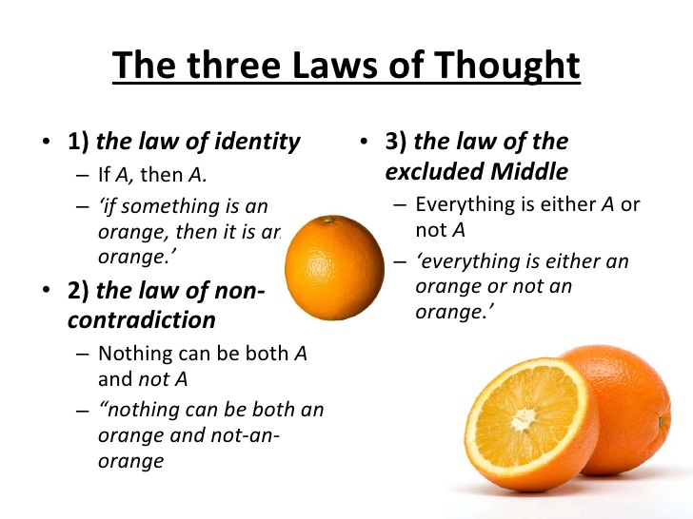
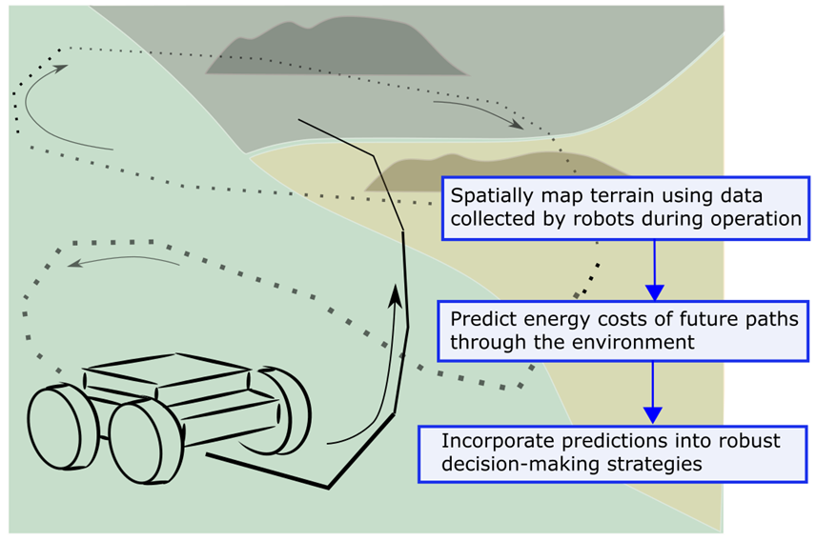
The Rationalistic Approach Approach to AI
Rationalistic Thinking:
  The “laws of thought” (Logic) approach
    Aristotle attempted to codify an irrefutable reasoning processes.
    His syllogisms provided patterns for argument structures that always yielded correct conclusions when given correct premises
  The Logic approach assumes a certain deterministic world – does not incorporate uncertainty (stochastic nature)
  The theory of probability fills this gap, allowing rigorous reasoning with uncertain information

Slide 11
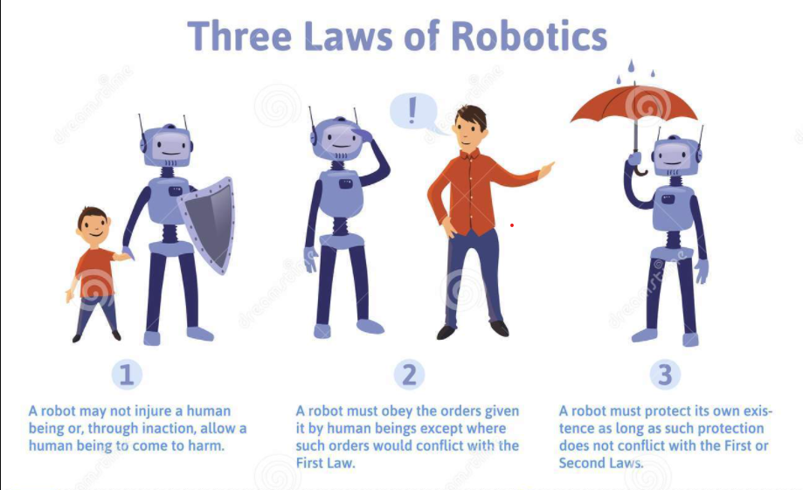
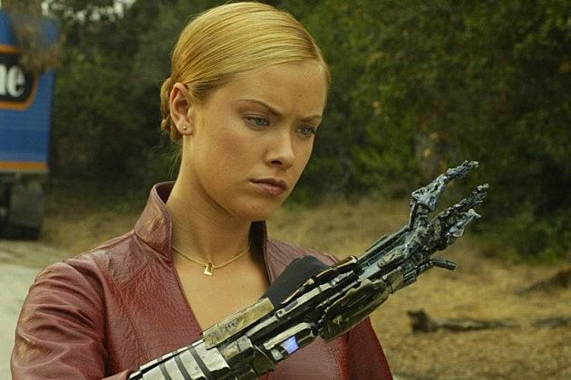

The Rationalistic Approach Approach to AI
Rationalistic Action (for systems that operate and act autonomously):
  A.K.A. the Rational Agent Approach
  An agent is just something that acts (agent comes from the Latin agere, to do)
  A rational agent is one that acts so as to achieve the best outcome or,
  Best outcome is defined by the objective given to the agent (Utility based)
  Rationality in some context’s may not be limited to making inferences as in Logic
    E.g. recoiling from a hot stove is a reflex action
  Another illustration is learning not only for erudition, but also because it improves our ability to generate effective behavior, especially in circumstances that are new
  (improvise)
  Vs

Slide 12
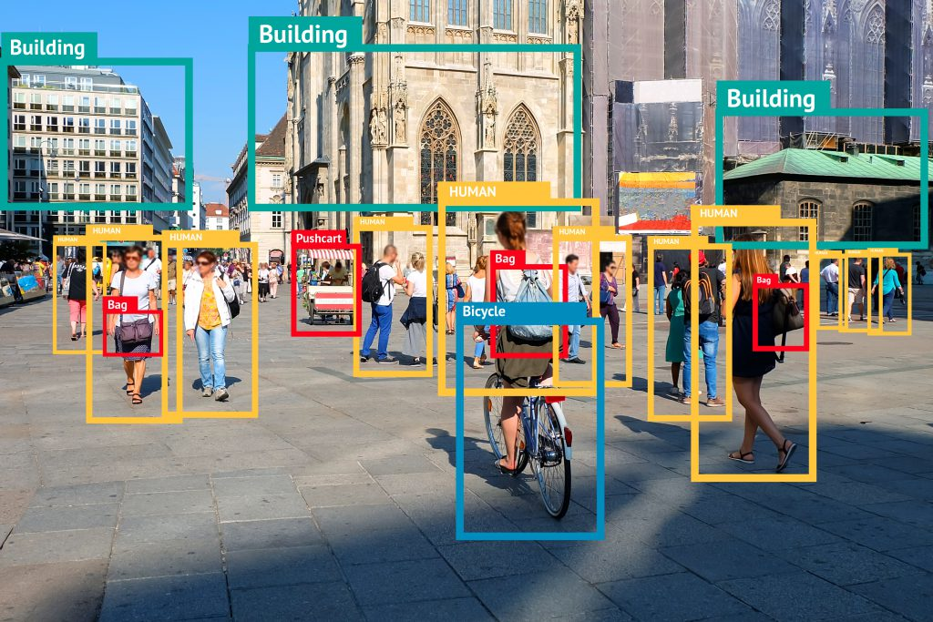
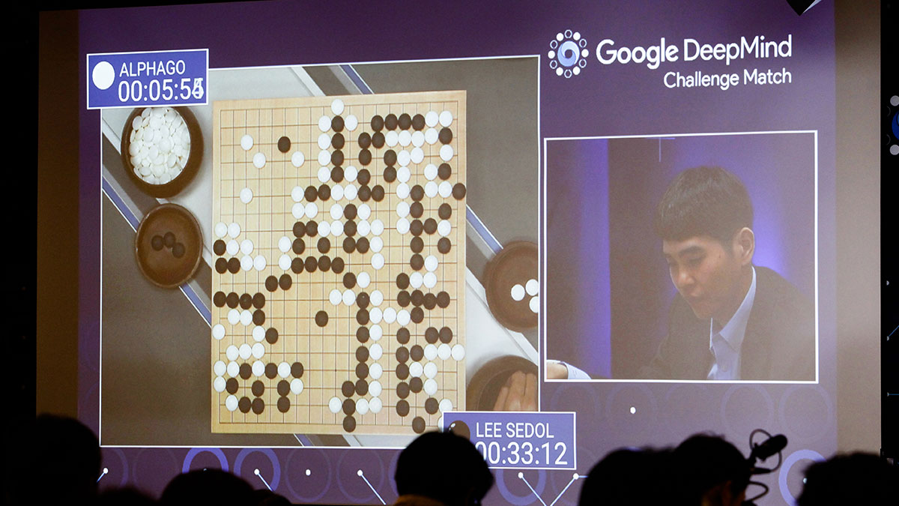
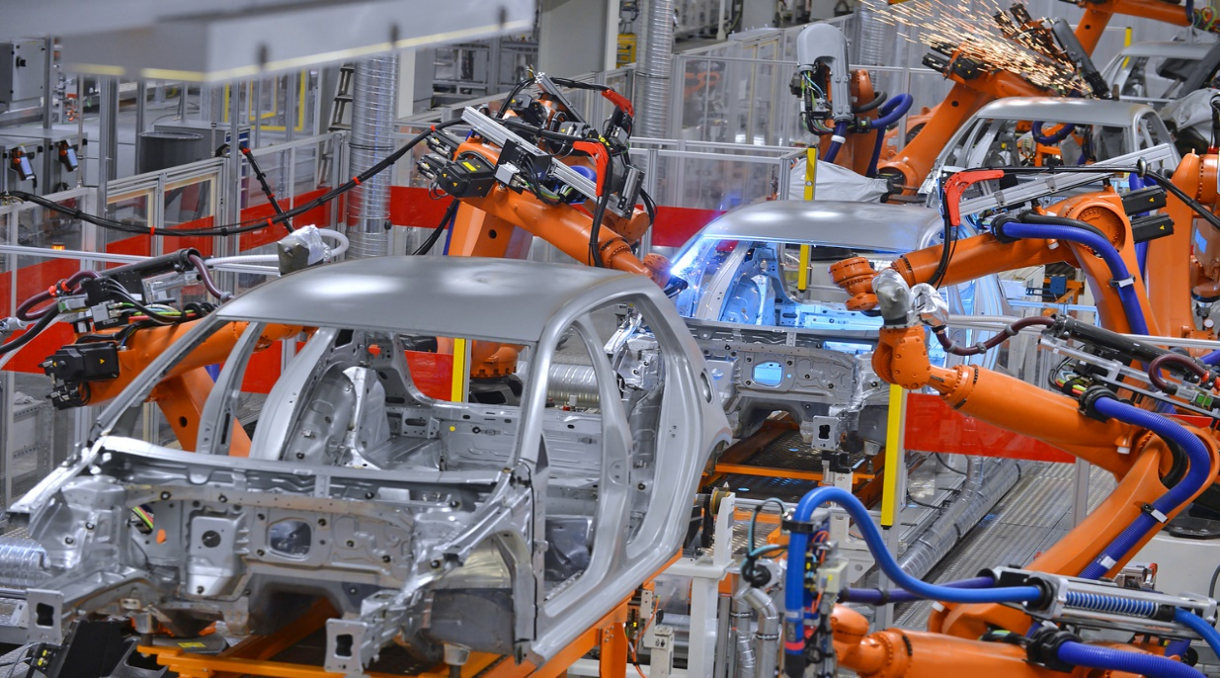
Application Areas of AI
Automating both the mundane and expert tasks
Paradoxically, it turns out that it is the mundane tasks that are generally much the hardest to automate
  Mundane Tasks (Image and Pattern Recognition)
    Robots in Assembly plants etc.
  Natural Language Processing (understanding, generation, translation)
  Formal Tasks (Games, Puzzles, Mathematics)
  Expert Tasks (Medical Diagnosis, Fault finding, Engineering)

Slide 13
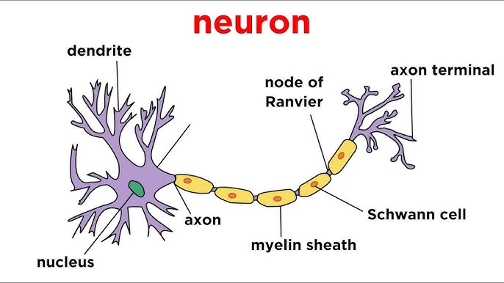
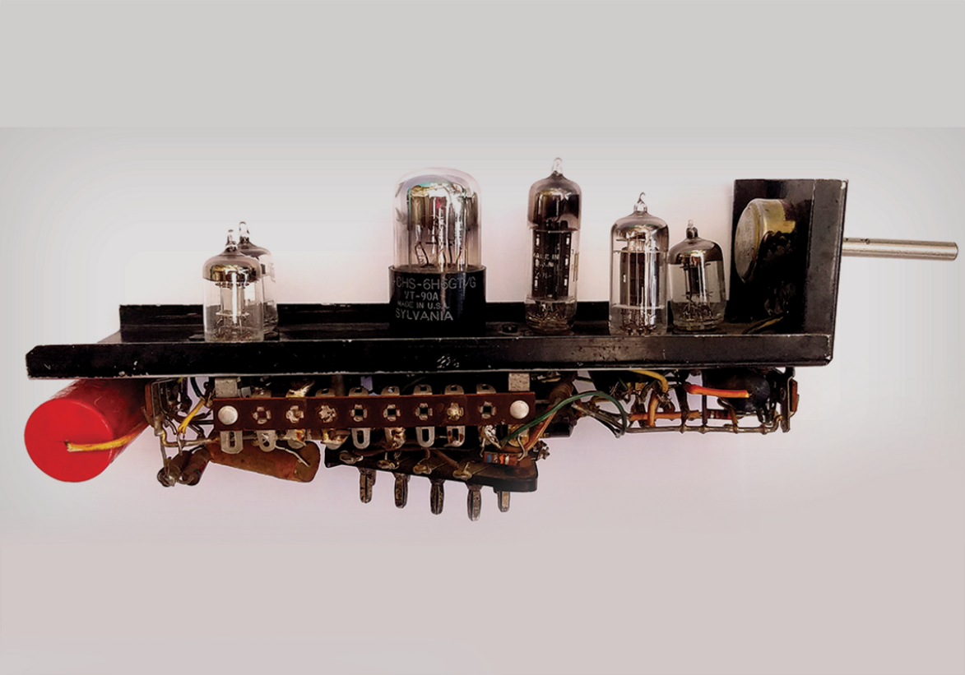
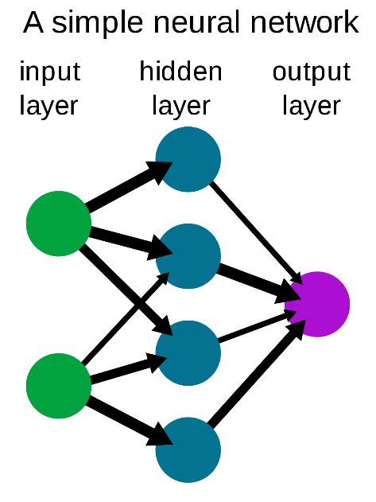
History of AI
The inception of artificial intelligence (1943–1956)
  First work by Warren McCulloch and Walter Pitts (1943).
  They proposed a model of artificial neurons in which
  each neuron is characterized as being “on” or “off,”
  Neuron’s switches state to “on” in response to stimulation by a sufficient number of neighboring neurons
  Two undergraduate students at Harvard, Marvin Minsky and Dean Edmonds, built the first neural network computer in 1950

Slide 14
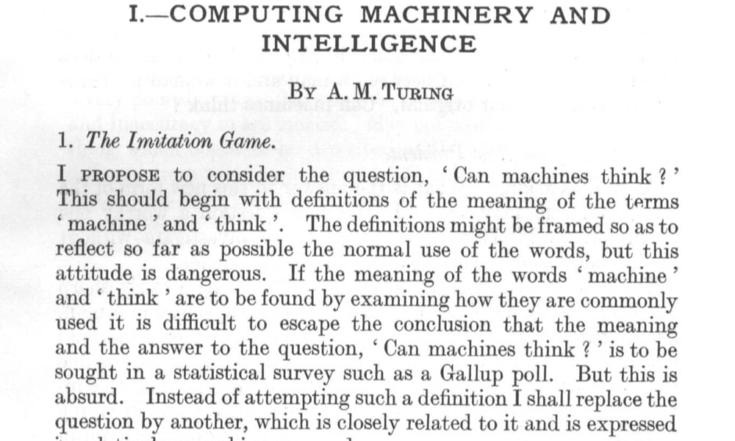
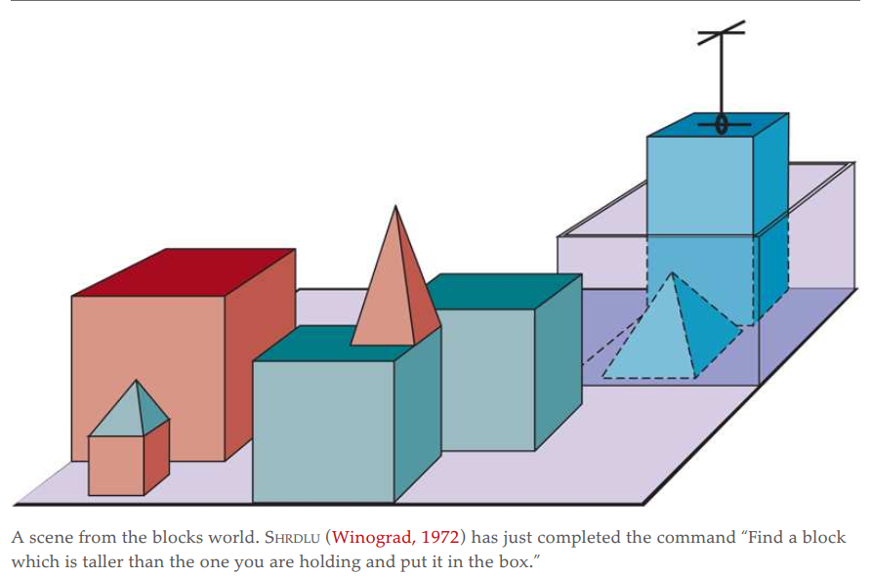
History of AI - Continued
The inception of artificial intelligence (1943–1956)
  Alan Turing published the article “Computing Machinery and Intelligence” introducing the Turing test, machine learning, genetic algorithms, and reinforcement learning
Early enthusiasm, great expectations (1952–1969)
  Herbert Gelernter (1959) constructed the Geometry Theorem Prover, which was able to prove theorems that many students of mathematics would find quite tricky
  Minsky supervised a series of students who chose limited problems/domains (microworlds)that appeared to require intelligence to solve.
  Blocks world: a microworld where typical task in this world is to rearrange the blocks in a certain way, using a robot hand that can pick up one block at a time

Slide 15
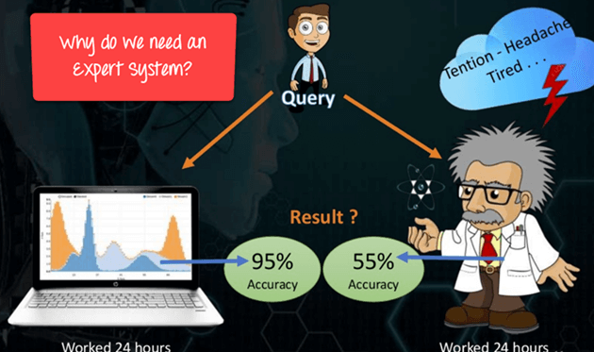
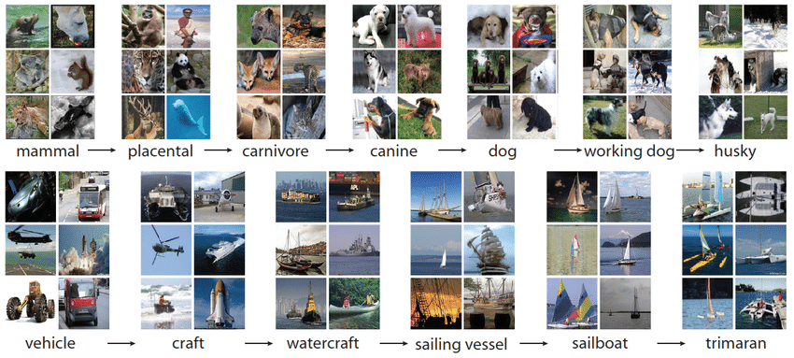
History of AI - Continued
Expert systems (1969–1986)
  Expert system is a computer system emulating the decision-making ability of a human expert.
  Expert systems are designed to solve complex problems by reasoning through bodies of knowledge, represented mainly as if–then rules
  E.g. MYCIN system (1970s) used for diagnosing blood infections. With about 450 rules, MYCIN was able to perform as well as some experts
Deep learning (2011–present):
  Deep learning refers to machine learning using multiple layers of simple, adjustable computing elements (e.g. Neurons)
  In the form of convolutional neural networks they found some success in handwritten digit recognition in the 1990s
  ImageNet competition which used of 14 million images to perform a classification task in to 1000 categories – 63% accuracy achieved (2012)

Slide 16
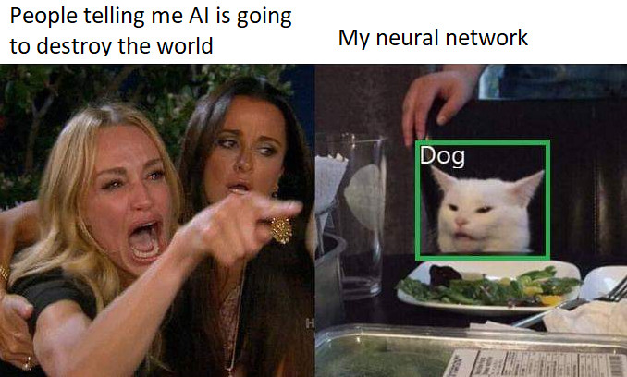
What is the ultimate goal of AI?
Two major factions exist concerning the ultimate goal of AI
  Weak AI Advocates:
    If people need to make a computer that thinks, they should replace the circuits with proteins.
    Generally, able to make robust computer systems that mostly provide decision support and decision making
    Work on limited set of problems
  Strong AI Advocates:
    In the future technologists will one day be able to build a computer with all the cognitive, memory, and emotional capabilities of the human brain.
    They believe that computers will someday be more intelligent than human beings
    Work on diverse range of problems

Slide 17
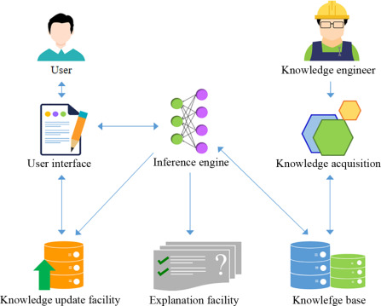
Knowledge based-Systems
Systems that use a knowledge base to make inferences for the purpose of problem solving
    Knowledge base: storage mechanism for complex information
      Consisted of facts about certain discipline or a topic at hand
    Inference Engine/Reasoning System: inferring/deducing new knowledge from the KB using if-then rules
Knowledge base is different from regular databases (relational) as it has:
  Pointer linked data in several chains (both forward and backward)
  This in turn provides something that looks like an object model (classes, subclasses, instances)

Slide 18
Reading Assignment
1.Compare and contrast the difference and similarities between human intelligence and artificial intelligence.
2.Define in your own words: (a) intelligence, (b) artificial intelligence, (c) agent, (d) rationality, (e) logical reasoning
3.Is AI a science, or is it engineering? Or neither or both? Explain.

